Slide 1
Atmosphere Rendering Magyar Anna
Konzulens: Fridvalszky András Máté

Slide 2
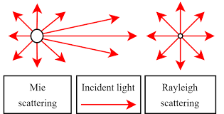
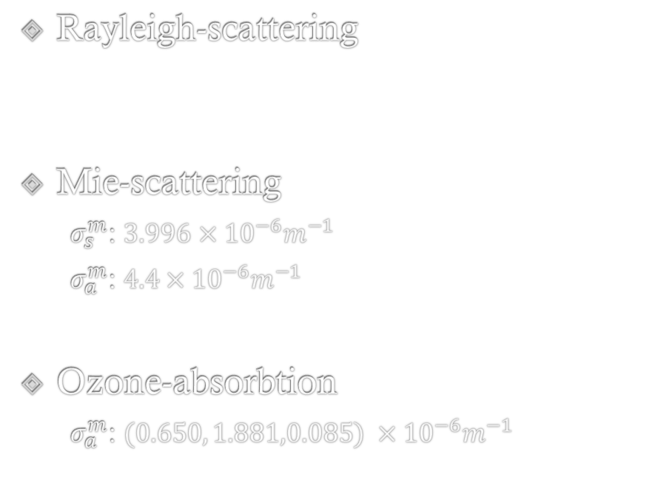


Légköri komponensek
Rayleigh-scattering
Mie-scattering
$σ_{s}^{m}$: $3.996$ $×{10}^{−6}m^{−1}$
$σ_{a}^{m}$: $4.4×{10}^{−6}m^{−1}$
Ozone-absorbtion
$σ_{a}^{m}$: $(0.650, 1.881,0.085) ×{10}^{−6}m^{−1}$
$σ_{s}^{r}: (5.802, 13.558, 33.1$) $×{10}^{−6}m^{−1}$
Extintion:
$$σ_{t}\left(x\right)=\left(σ_{s}\left(x\right)+σ_{a}\left(x\right)\right) d\left(h\right)$$
scattering
absorbtion
Magasság szerinti részecskeeloszlás

Slide 3

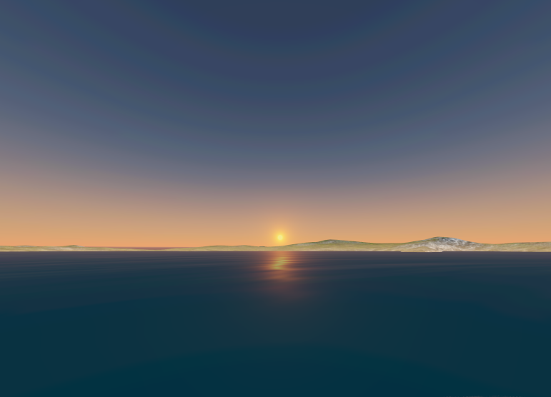

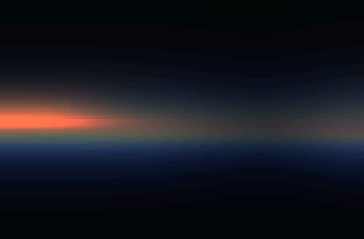
LUT generation
Transmittance
MultipleScattering
SkyView

Slide 4
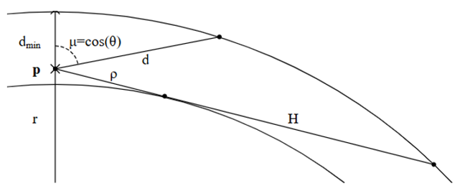




Transmittance
$$T\left(x_{a},x_{b}\right)=ⅇ^{−\int_{x_{a}}^{x_{b}}{σ_{t}\left(x\right)\left\|ⅆx\right\|}}$$
Heigth (r)
$$σ_{t}\left(x\right)=\left(σ_{s}\left(x\right)+σ_{a}\left(x\right)\right)d\left(h\right)$$
Sun_$\cos{θ}$
Paraméterezés:
$ρ=H⋅v$
$d=d_{min}+u⋅(d_{max}−d_{min})$
$μ=\cos{θ}=\frac{H^{2}−ρ^{2}−ⅆ^{2}}{2⋅r⋅d}$

Slide 5
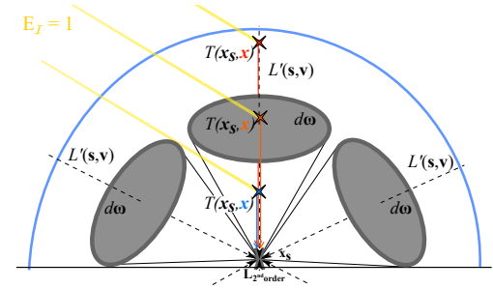

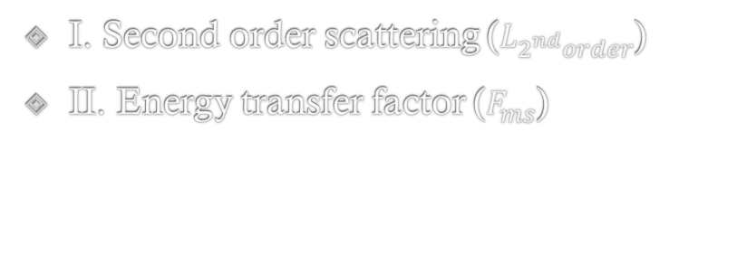




Multiplescattering $$ψ_{ms}=L_{2^{nd}order}{ F}_{ms}$$
$$u=0.5+0.5 cosθ$$
$$v=\frac{h−B}{T −B}$$
I. Second order scattering ($L_{2^{nd}order}$)
II. Energy transfer factor ($F_{ms}$)
heigth
$$L_{2^{nd}order}=\int_{Ω4π}{L^{′}\left(x_{s}, −ω\right)ρ_{u} ⅆω}$$
Sun_$\cos{θ}$
I.
$$L^{′}\left(x,v\right)=T{\left(x,p\right)L}_{0}\left(p,r\right)+\int_{t=0}^{\left\|p−x\right\|}{σ_{s}\left(x\right)T\left(x,x−tv\right)S\left(x−tv,ω_{s}\right){ ρ}_{u} E dt}$$
Luminance from the ground

Slide 6
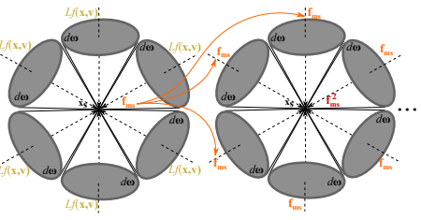
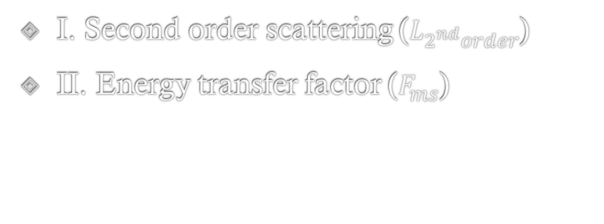




Multiplescattering $$ψ_{ms}=L_{2^{nd}order}{ F}_{ms}$$
I. Second order scattering ($L_{2^{nd}order}$)
II. Energy transfer factor ($F_{ms}$)
heigth
$$f_{ms}=\int_{{Ω4π}_{}}{L_{f}\left(x_{s},−ω\right)ρ_{u}ⅆω}$$
Sun_$\cos{θ}$
II.
$$L_{f}\left(x,r\right)=\int_{t=0}^{\left\|p−x\right\|}{σ_{s}\left(x\right)T\left(x,x−tv\right) 1 dt}$$
$$F_{ms}=\frac{1}{1−f_{ms}}$$

Slide 7
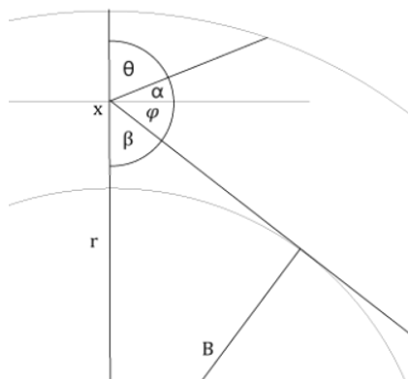









SkyView
$$\frac{π}{2}$$
$L\left(c,v\right)=T\left(c,p\right)L_{0}\left(p,v\right)+$ $\int_{t=0}^{\left\|p−x\right\|}{L_{scatt}\left(c,c−tv,v\right) dt}$
Altitude$∡$
(l)
$$L_{scatt}\left(c,x,v\right)=σ_{s}\left(x\right)\sum_{i=1}^{Nlight}{\left(T\left(c,x\right)S\left(x,l_{i}\right)ρ\left(v,l_{i}\right)+ψ_{ms}\right)E}$$
$$−\frac{π}{2}$$
0
$$π$$
Azimuth$∡$
$(a)$
Paraméterezés:
$$v=0.5+0.5⋅\operatorname{sign}\left(l\right)\sqrt{\frac{l}{π/2}}$$
u$=\sqrt{\frac{a}{π}}$

Slide 8
LUT generation
Transmittance
MultipleScattering
SkyView

Slide 9
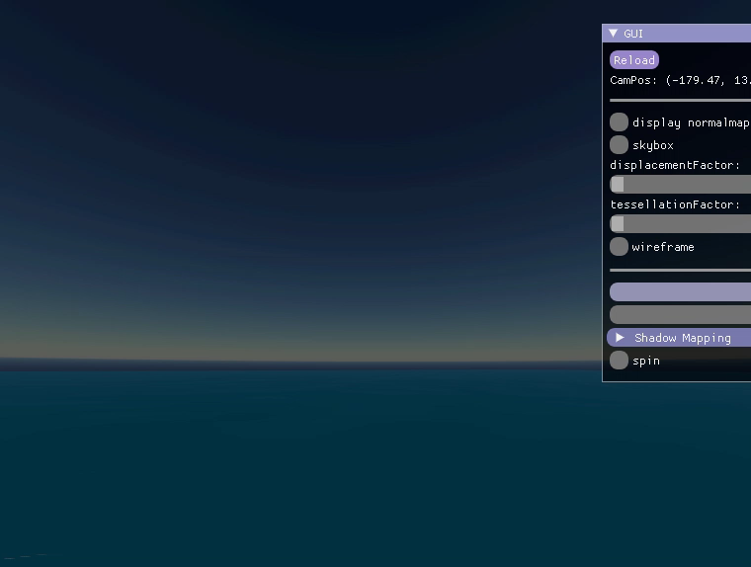

Slide 10
Köszönöm a figyelmet!

